Slide 1
Real world analysis 4
Effect size, discrepancy measures and assorted tests.

Slide 2
Today
Effect size
Standardized
Natural
Clinical
Simple exercises online
Code review
Individual support

Slide 3
For the reader to appreciate the magnitude or importance of a study’s findings, it is almost always necessary to include some measure of effect size in the Results section” (APA, 2016, p. 3).

Slide 4
Standardised effect size measures
We want a way of comparing how large an effect is between studies.
Different measures
Different interventions, settings etc…
Comparison between studies in meta analysis
Three types:
- relationships
- differences
- variance explained

Slide 5
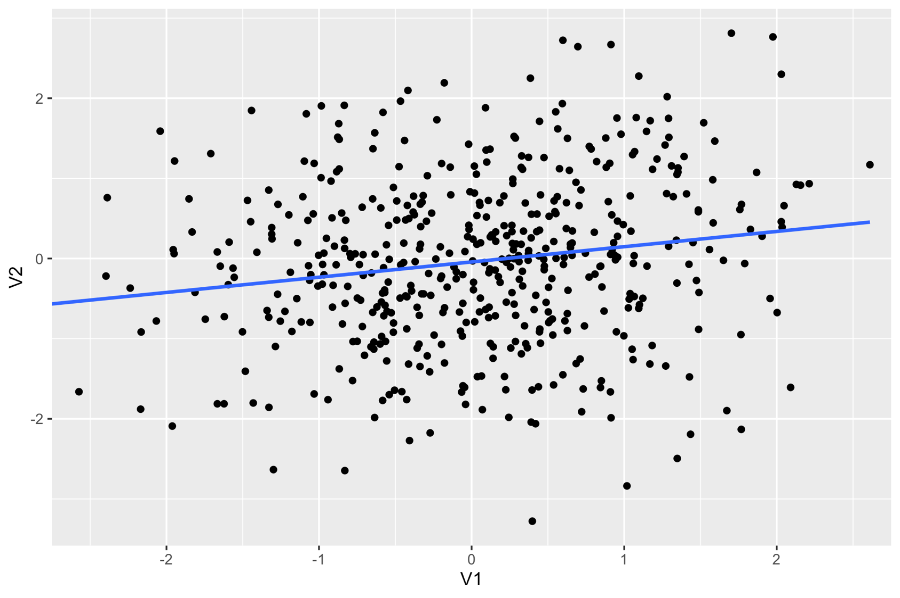

Slide 6
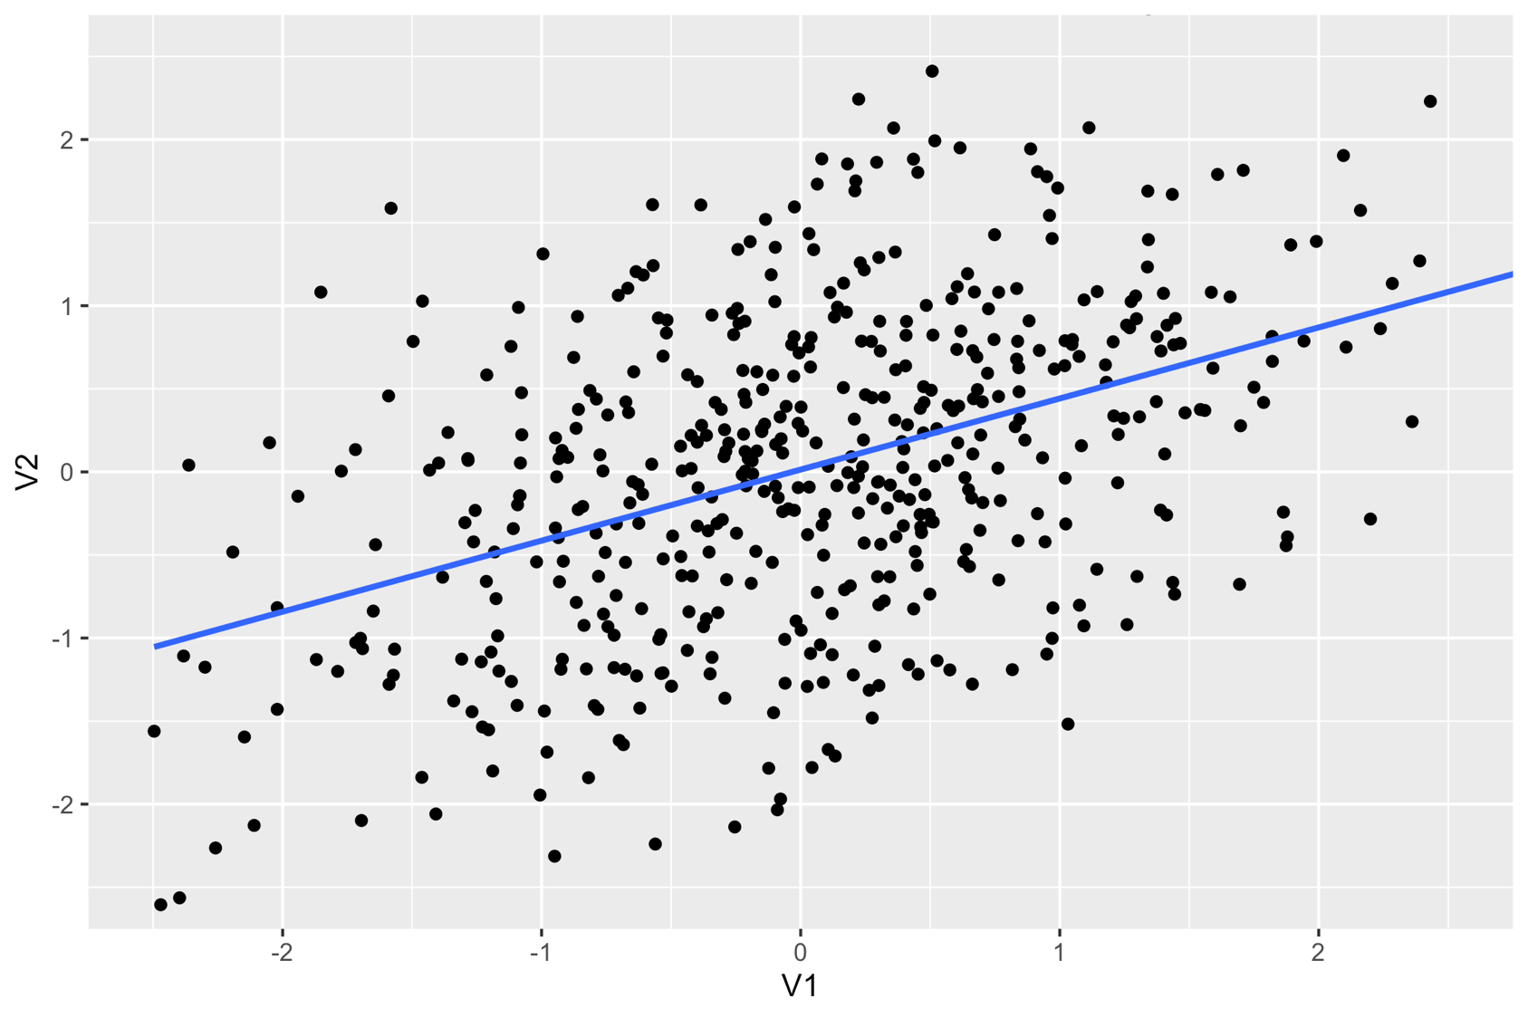

Slide 7
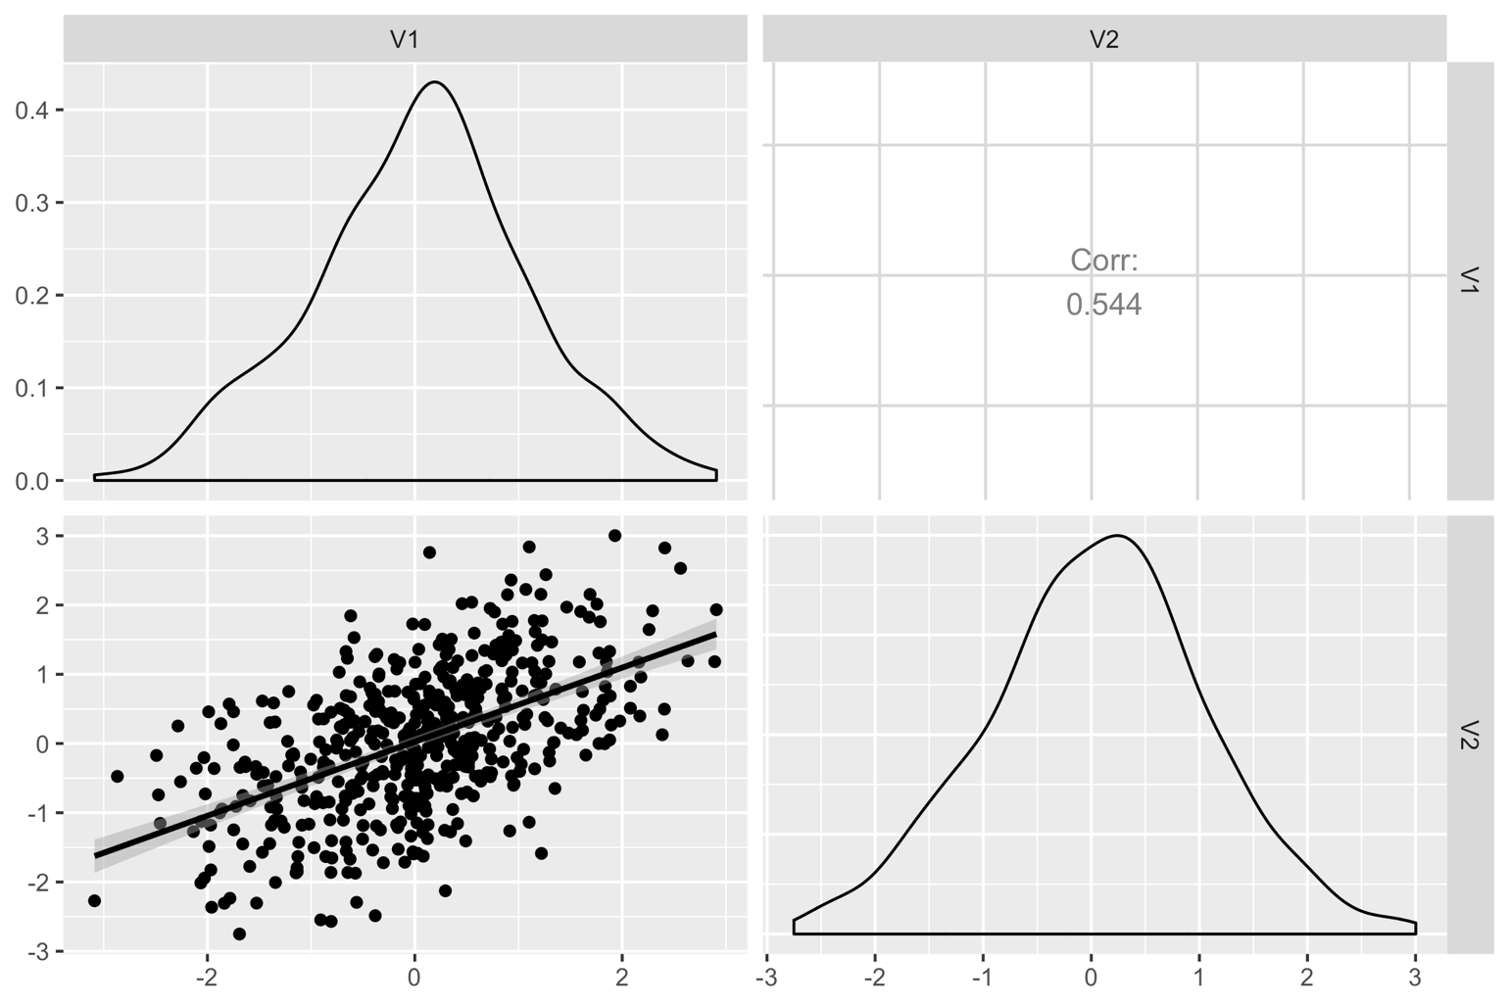

Slide 8
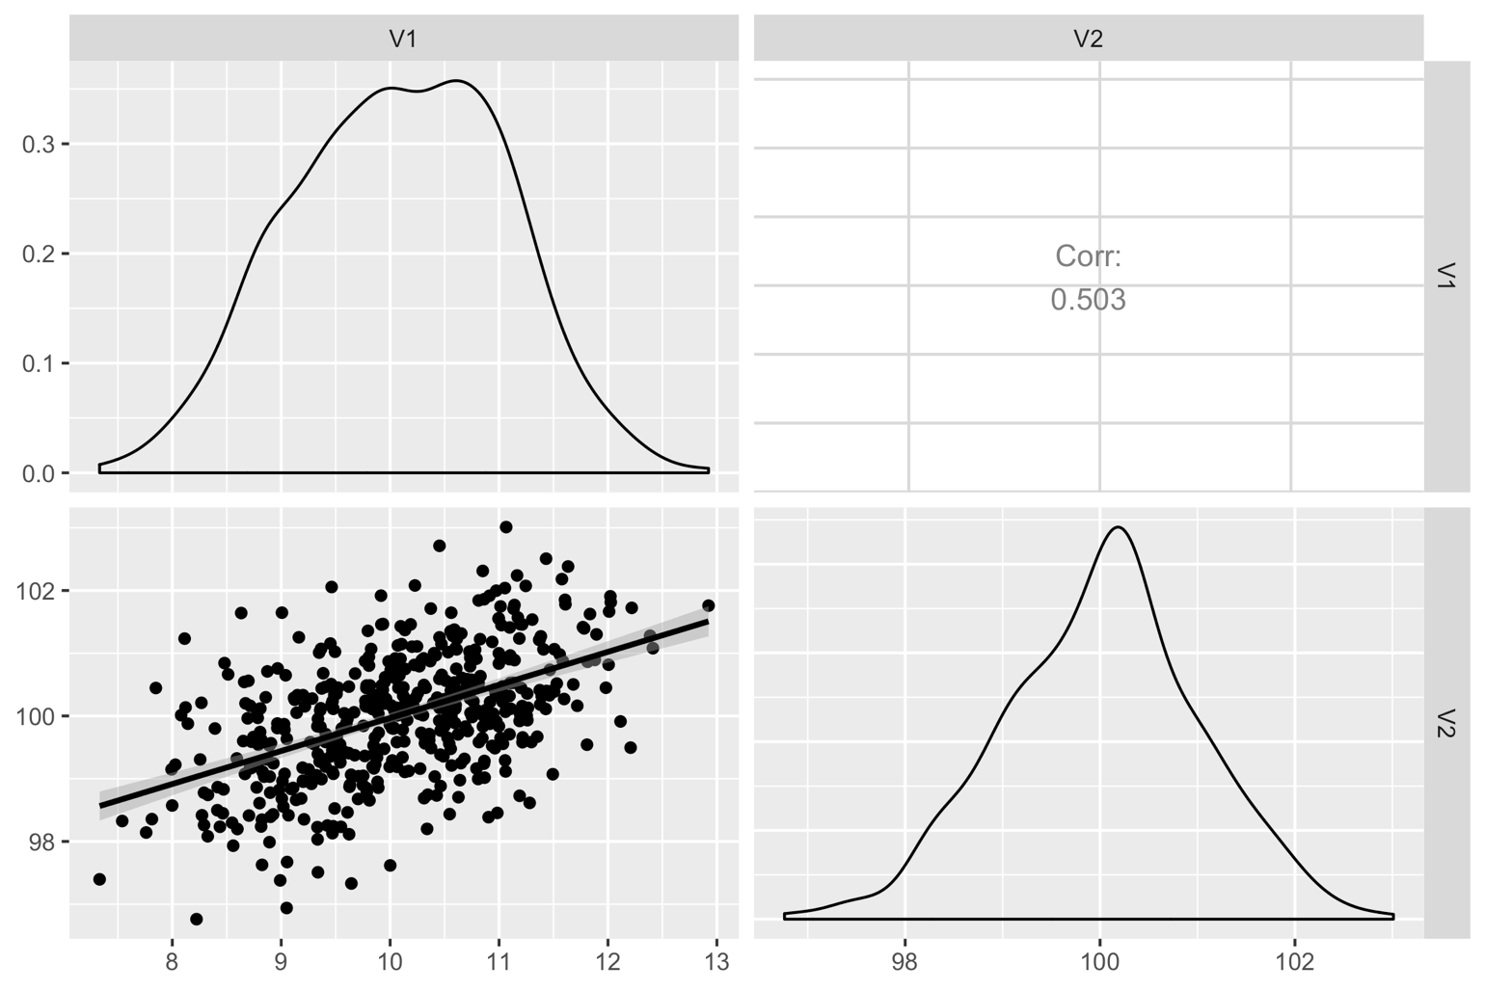

Slide 9
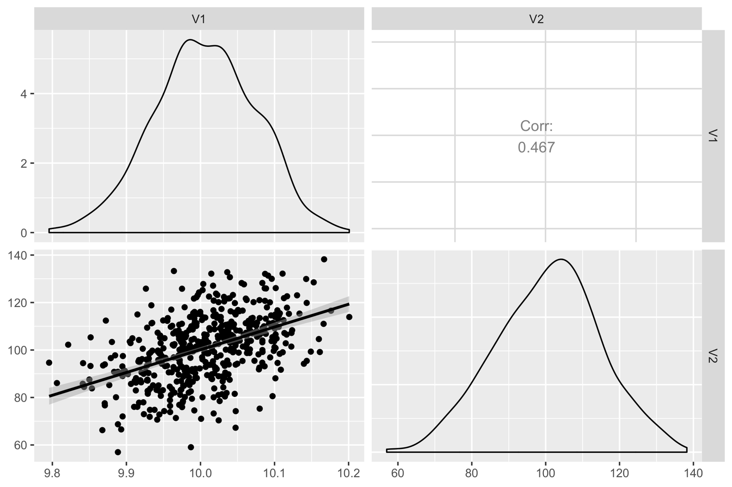

Slide 10
Correlation
Measure of relationship strength or effect size
Insensitive to (unaffected by):
Means
Variances

Slide 11
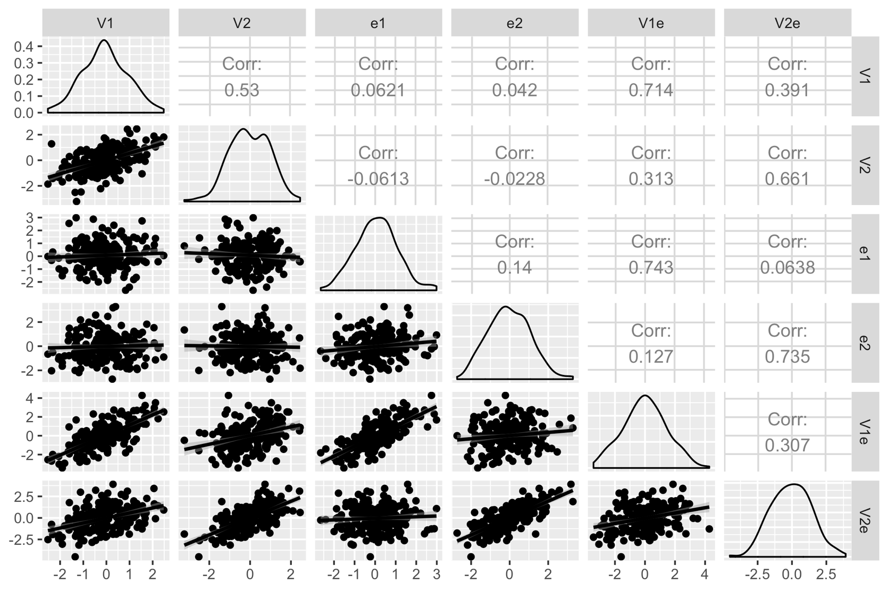




Slide 13
Limitations
Correlations assume a linear relationship.
Correlations (as effect sizes) assume NO measurement error
This is also true of regression predictors
outcome = predictor × coefficient + error
We only have an error on the right-hand side

Slide 14
Effect sizes for group differences

Slide 15

Δ
SD A
SD B

Slide 16
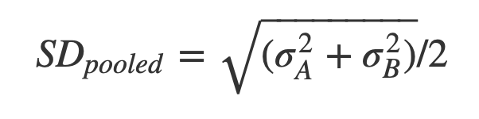
Cohen’s D
Difference
Divided by
Pooled
Standard
Deviation
DIDPOOS

Slide 17
Interpreting Cohen’s D
Rules of thumb
Important to place confidence interval around D
i.e. “D = .5, 95% CI = 0.1 to 0.9”
 | Cohen’s D | Pearson ρ (rho) | Variance explained
Small effect | 0.2 | .1 | 1%
Medium Effect | 0.5 | .3 | 6% / 9%
Large Effect | 0.8 | .5 | 16% / 25%

Slide 18
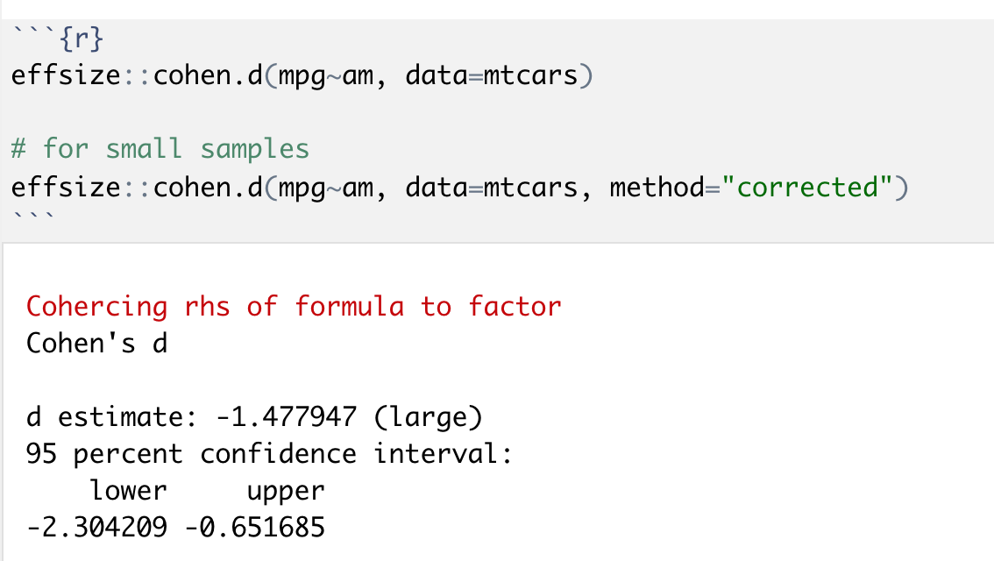
Cohen’s D in R

Slide 20
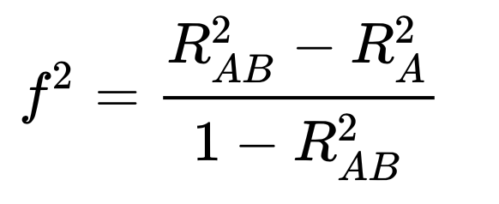
Effect size as variance explained
f²
Partial eta²
Nice discussion/comparison/explanation: https://www.theanalysisfactor.com/effect-size/
Reference for many different calculations/scenarios: https://www.psychometrica.de/effect_size.html
E.g. can calculate eta sq and cohen’s D from an Anova F statistic
Another good reference: http://imaging.mrc-cbu.cam.ac.uk/statswiki/FAQ/effectSize
effsize package has many different statistics

Slide 21
Effect sizes may be expressed in their original units (e.g. …kg/month…) and are often most easily interpreted when expressed in their original units” (APA, 2016, p. 3).

Slide 22
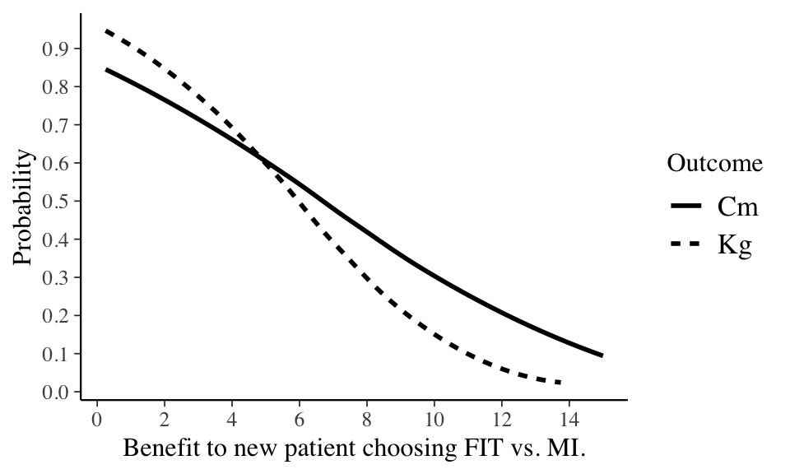

Slide 23
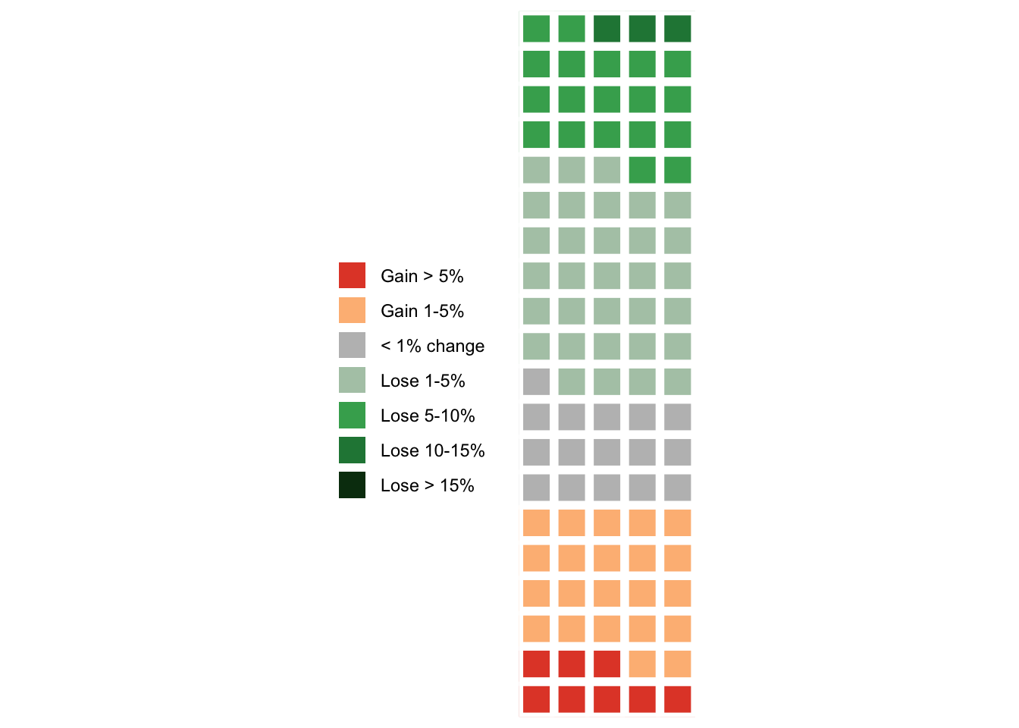
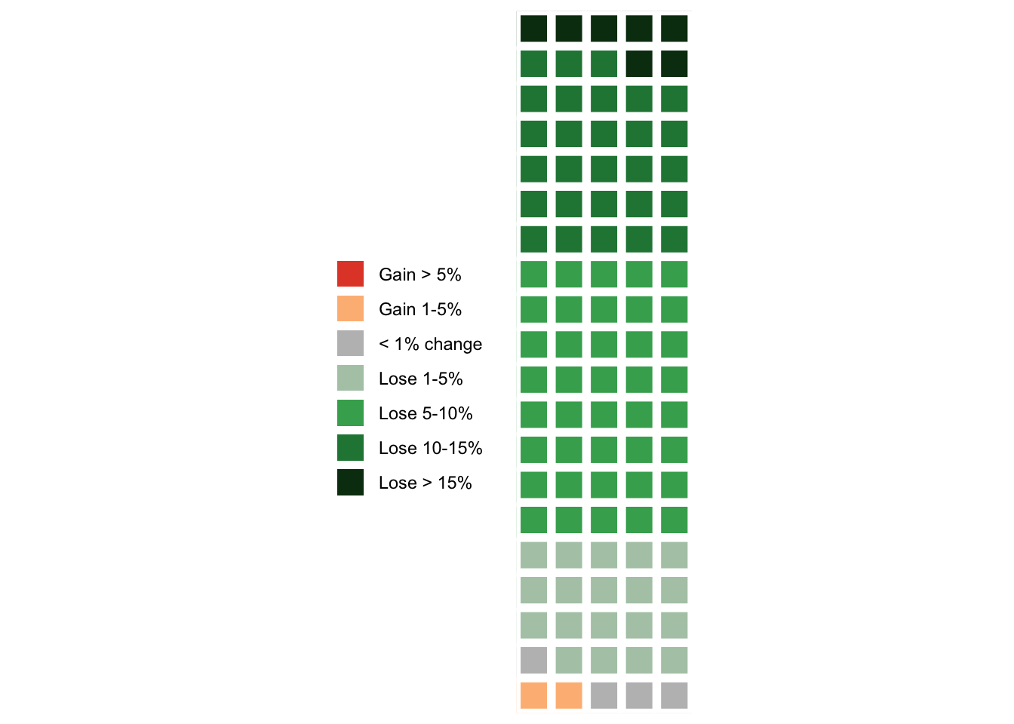
MI
FIT
Solbrig, L., Whalley, B., Kavanagh, D. J., May, J., Parkin, T., Jones, R., & Andrade, J. (2019). Functional imagery training versus motivational interviewing for weight loss: a randomised controlled trial of brief individual interventions for overweight and obesity. International Journal of Obesity, 43(4), 883-894.
Gigerenzer, G. (2011). What are natural frequencies?. Bmj, 343, d6386
Galesic, M., Gigerenzer, G., & Straubinger, N. (2009). Natural frequencies help older adults and people with low numeracy to evaluate medical screening tests. Medical Decision Making, 29(3), 368-371.
Chicago

Slide 24
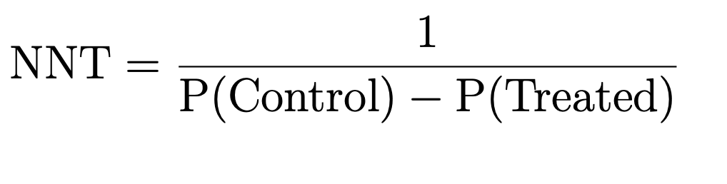
NNT: Number Needed to Treat

Slide 25
Examples of NNTs
Antibiotics for bronchitis =
18
Asprin for stroke =
10,000
Statins for stroke =
268
Antidepressants for depression =
∼ 9
Psychotherapy for depression =
∼ 3

Slide 26
Defining treatment success
Clinically reliable change
Introduced in Jacobson, Follette, and Revenstorf (1984), but best summary is Jacobson and Truax (1991)
All measures involve uncertainty.
Reliable Change (RC) is about whether people changed sufficiently that the change is unlikely to be due to simple measurement unreliability.
Jacobson, Neil S, and Paula Truax. 1991. “Clinical Significance: A Statistical Approach to Defining Meaningful Change in Psychotherapy Research.” Journal of Consulting and Clinical Psychology 59 (1). American Psychological Association: 12.

Slide 27
Clinically reliable change
Measures have a reliability
Internal
Test-retest
Reliability limits how certain we can be
Want to say someone changed more than might be expected by chance
Is this ‘real’ change > 95% of the time?

Slide 28
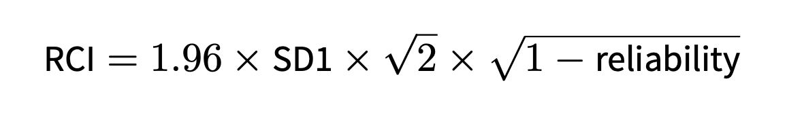
RCI: Reliable Change Index

Slide 29
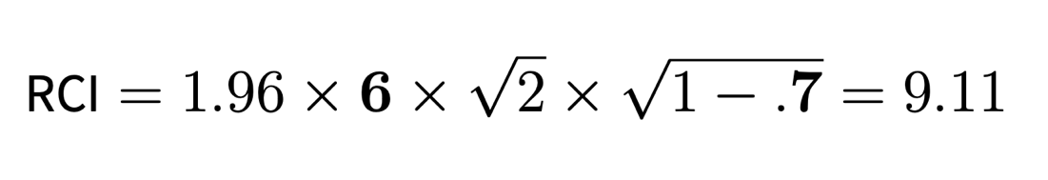


RCI: Reliable Change Index Worked example for Hamilton Depression Scale
SD of HRSD at baseline
Test-retest reliability (correlation) of HRSD

Slide 30
Summary of today
Effect size measures are important
Contextualise results
Avoid “star-blindness”, especially in non-applied work
Standardised measures can be useful
Comparison between studies/domains (can convert between units)
But sensitive to variation
Natural units can be clearer
Especially in applied work, report both
Reliable/clinically meaningful change also useful

Slide 31
Assessment
“Replicate the statistical analysis using methods which are appropriate to the data.”
“Compare/contrast your results with the published manuscript as appropriate. ”
“Discuss the extent to which the concept of ‘researcher degrees of freedom’ (Simmons et al 2011; Gelman and Loken 2013) should influence our understanding of your chosen study.”
“You do not need to use the exact method used in the original paper in all cases; the point of the exercise is to apply methods we have learned in an appropriate way. For example, you may wish to apply Bayesian techniques to a dataset previously analysed with frequentist methods; this would provide additional opportunity to demonstrate understanding of the material and appropriate application of techniques.”

Slide 32
What is expected
Replicate the paper exactly, as best you can.
Apply techniques from the course appropriately to make sense of the data as best you can.
Sometimes this will mean reporting additional analyses, or sensitivity analyses. This will help with the question on researcher degrees of freedom.

Slide 33

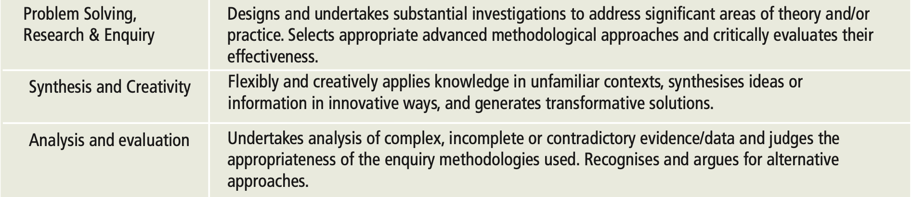
SEEC Level 7 Attributes
http://www.seec.org.uk/wp-content/uploads/2016/08/SEEC-descriptors-Dec10.pdf

Slide 34
Housekeeping
Final session on 21st April (same Zoom link)
Assessment dates on DLE
Office hours at 1pm Tu, Th.
Let me know in advance if possible
Zoom link for office hours: https://plymouth.zoom.us/j/9101503592

